Slide 1
Project 1: Assessing the Effectiveness in Drug A on Fasting Sugar Levels
Medha Mallampati SHP Rutgers University BINF5210: Health Data Analytics with SAS Riddhi Vyas

Slide 2
Study Overview
A study was conducted to determine whether Drug A helps to reduce fasting sugar levels. There are 3400 patients enrolled for this study and the fasting sugar levels were taken before and after consuming Drug A at a certain time interval.

Slide 3
Background
What is considered normal fasting blood sugar levels?
Anything between 70 mg/dL – 120 mg/dL
What is hyperosmolar and hypoglycemia?
Hyperosmolar is when the patient has very high blood sugar levels, over 600 mg/dL
Hypoglycemia is when the patient has very low blood sugar levels, reaching as low as 40 mg/dL

Slide 4
Objective
I want to know for patients with blood sugar levels between 40 – 600 if there is a difference between before and after taking Drug A in blood sugar levels. If so, was that difference a significant decrease in blood sugar levels?
Is there a difference in after blood sugar levels between the age groups?
Similarly, is there a difference in after blood sugar levels between states?
Is there an interaction effect for age group and state?
Is length of stay correlated to initial sugar levels and after sugar levels?

Slide 5
Hypotheses
H₀: There is no difference between blood sugar levels before and after. H₁: There is a difference between blood sugar levels before and after.
H₀: There is no difference in after blood sugar levels between the age groups. H₁: There is a difference between the age groups blood sugar levels where it affects one group more than the others.
H₀: There is no difference in after blood sugar levels between the states. H₁: There is a difference between the states blood sugar levels where it affects one group more than the others.
H₀: The interaction of age and state has no effect on after blood sugar levels. H₁: The interaction of age and state does have an effect on after blood sugar levels.
H₀: Length of stay is not correlated to either initial blood sugar levels and after blood sugar levels. H₁: Length of stay is correlated to either initial blood sugar levels and/or after blood sugar levels.

Slide 6
Creating Dataset
Saved data from each excel sheet into text file
Created initial two dataset’s – First_Study and Second_Study
Dataset’s sorted by patient_id and state
Data merged [horizontal] by patient_id
Created new column Age Group
Filtered dataset – eliminated extreme values and cutoff initial blood sugar levels, limiting only between 40 – 600
Took random sampling of merged dataset. Total observations is 1000

Slide 7
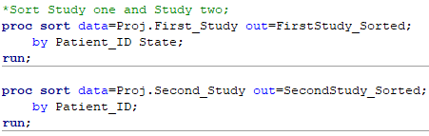
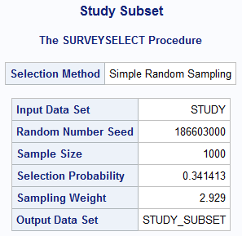
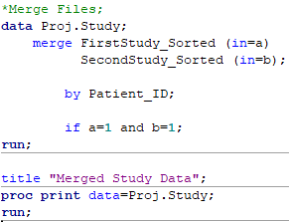

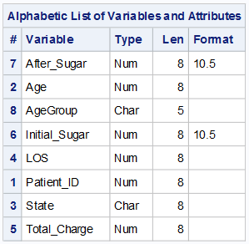
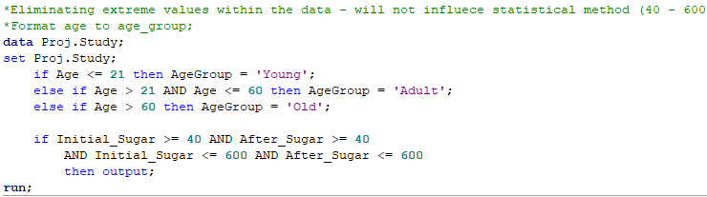

Slide 8
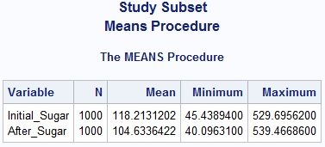
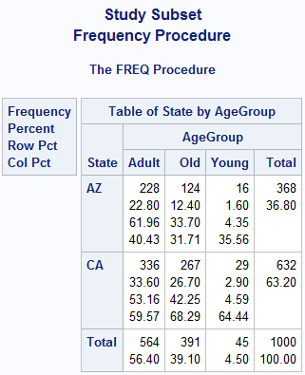
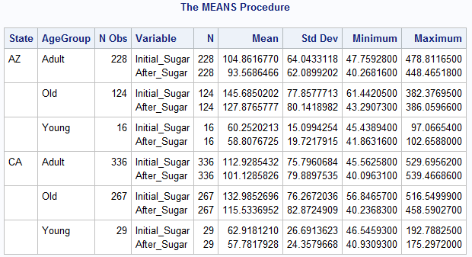
Descriptive Statistics
Procedure Means
Procedure Frequency

Slide 9
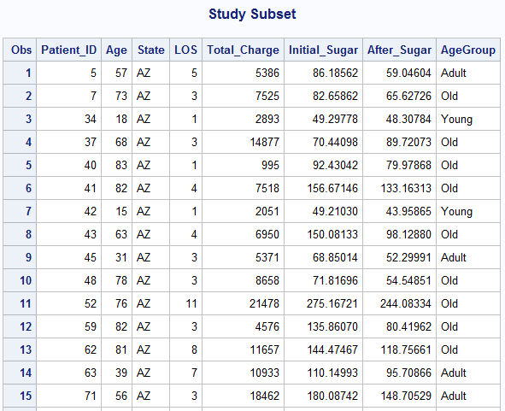
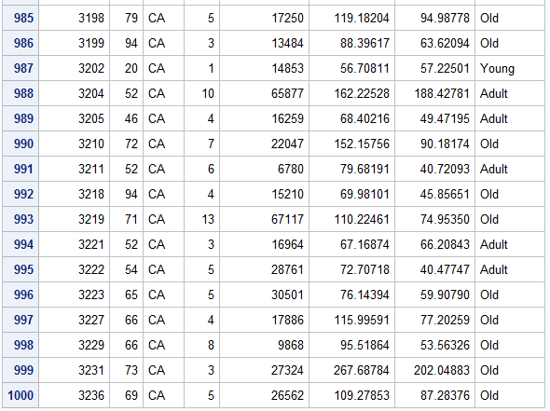
Final Data

Slide 10
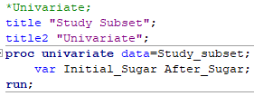
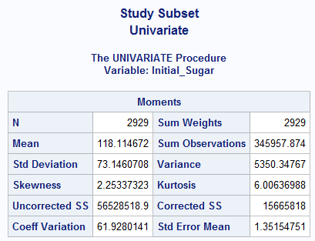
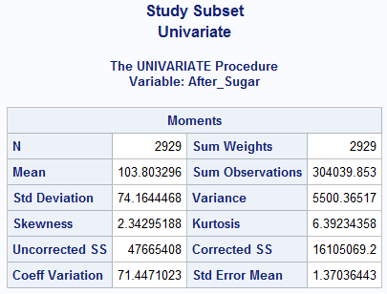
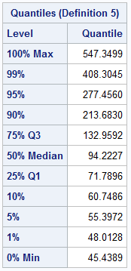
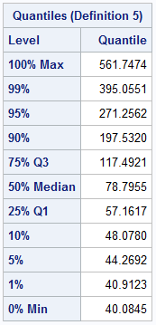
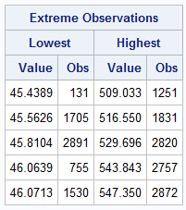
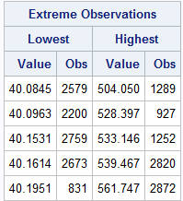
Univariate

Slide 11

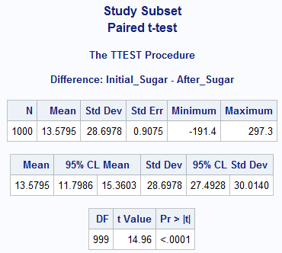
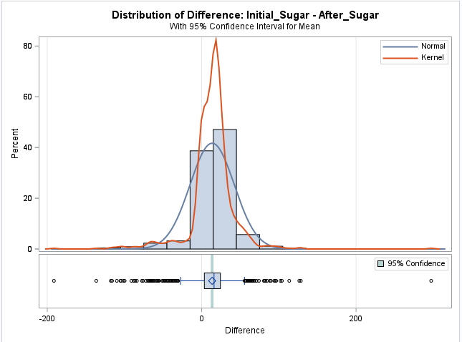
Objective I Results

Slide 12
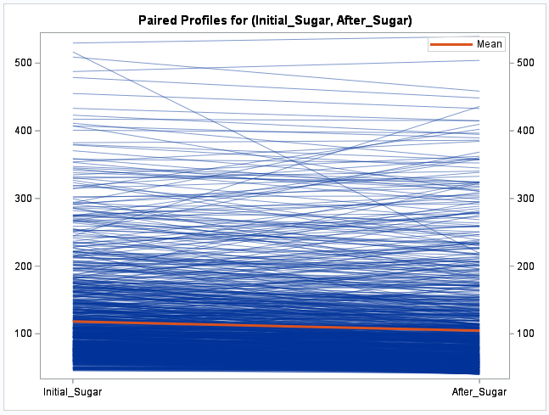
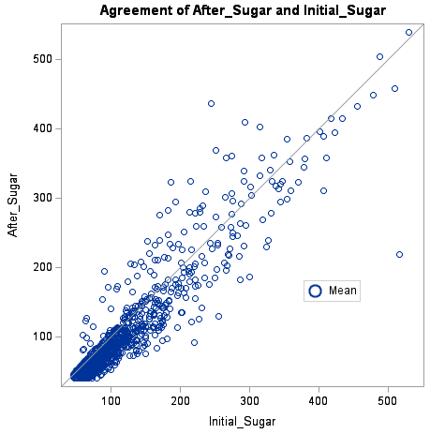

Slide 13


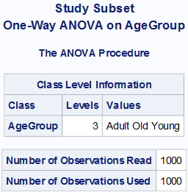
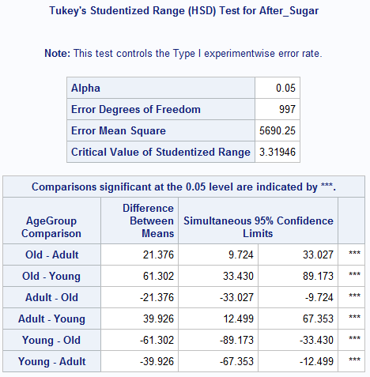
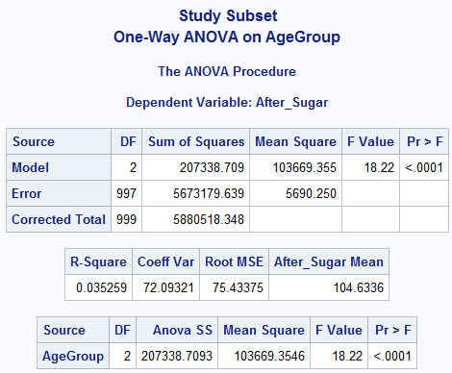
Objective II Results

Slide 14

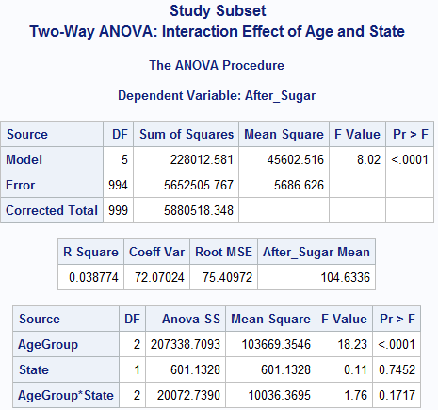
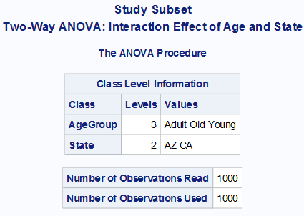
Objective II, III, IV Results

Slide 15

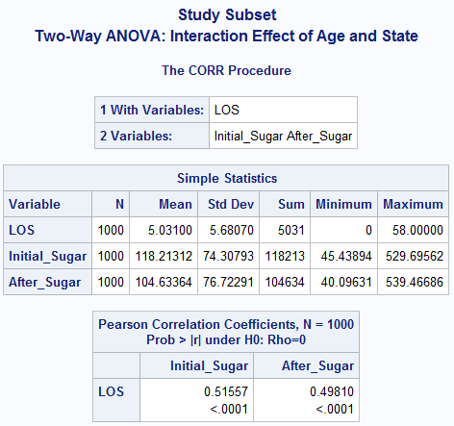
Objective V Results

Slide 16
Conclusion
I want to know for patients with blood sugar levels between 40 – 600 if there is a difference between before and after taking Drug A in blood sugar levels. If so, was that difference a significant decrease in blood sugar levels?
Alternative hypothesis accepted. There is a difference between blood sugar levels before and after, where it is shown there is a decrease in these levels.
Is there a difference in after blood sugar levels between the age groups?
Alternative hypothesis accepted. There is a difference between the age groups blood sugar levels where it affects all three age groups, with patients in age group ‘Old’ have the largest average in after blood sugar levels and patients in age group ‘Young’ have the lowest average.
Similarly, I want to know if there is a difference in after blood sugar levels between states?
Null hypothesis accepted. There is no difference in after blood sugar levels between the states.
Is there an interaction effect for age group and state?
Null hypothesis accepted. The interaction of age and state has no effect on after blood sugar levels.
Is length of stay correlated to initial sugar levels and after sugar levels?
Alternative hypothesis accepted. Length of stay is correlated to both initial blood sugar levels and after blood sugar levels, where both show a positive correlation.

Slide 17
References
Endocrine Society. (2022, March 31). Hypoglycemia. https://www.endocrine.org/patient-engagement/endocrine-library/hypoglycemia
Fallabel, C. (2022, February 19). What Levels of Blood Sugar Are Dangerous? Diabetes Strong. https://diabetesstrong.com/what-levels-of-blood- sugar-are-dangerous/
Hyperosmolar Hyperglycemic Syndrome. (2019, November 13). Cleveland Clinic. https://my.clevelandclinic.org/health/diseases/21147- hyperosmolar-hyperglycemic-syndrome
Hypoglycemia: Symptoms, Causes, Treatment & Safety Tips. (2021, March 25). Cleveland Clinic. https://my.clevelandclinic.org/health/diseases/11647-hypoglycemia-low-blood-sugar

